Slide 1
PIZZA SHOP - ANALYTICS
Kelompok 4
Gangsar FadhilMuhammad
Mahmud Arip
Mida Nopitasari

Slide 2
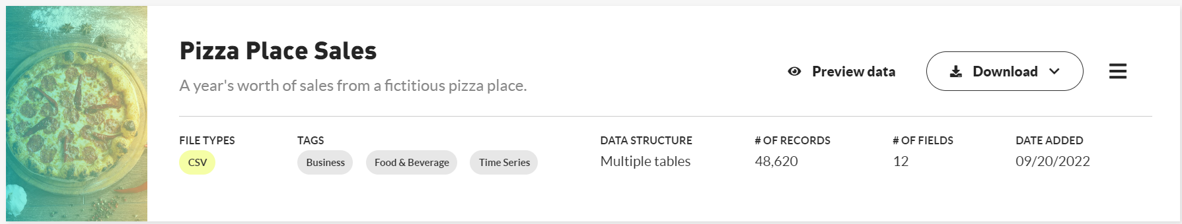
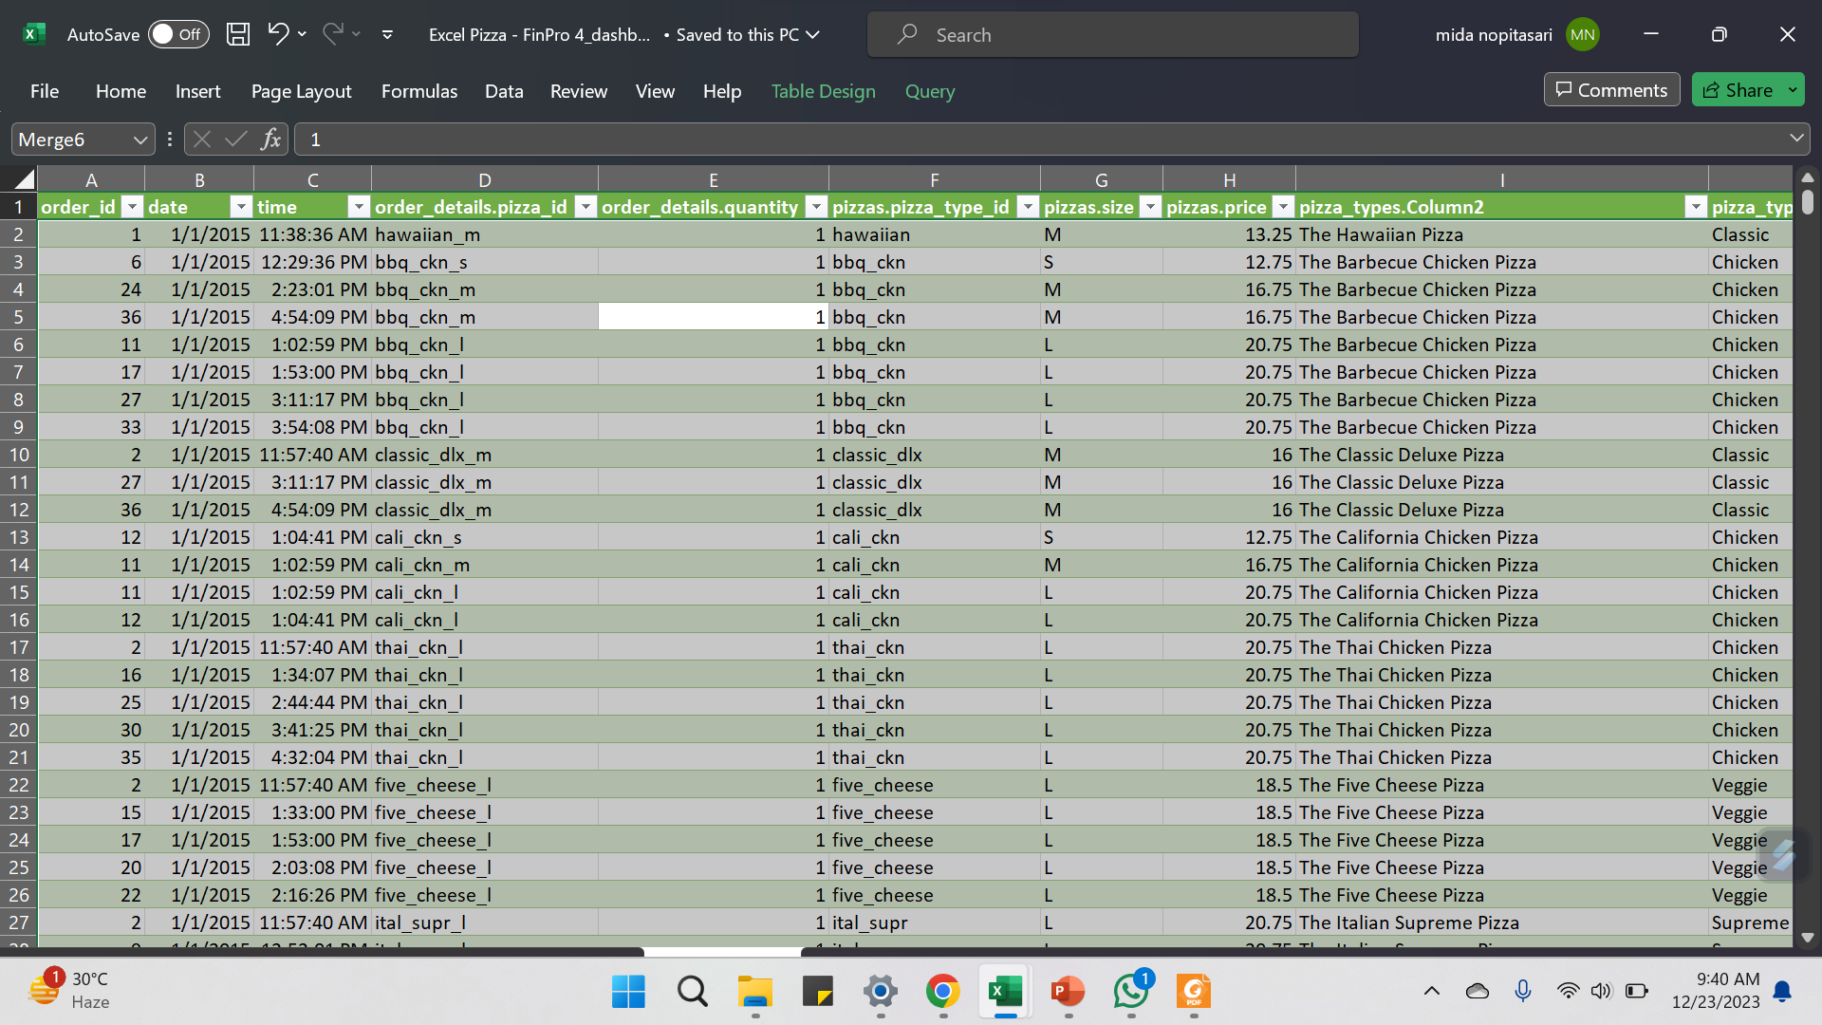
DATA PREPARATION – RAW DATA

Slide 3
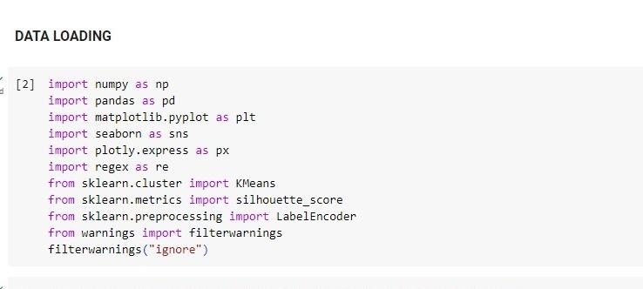
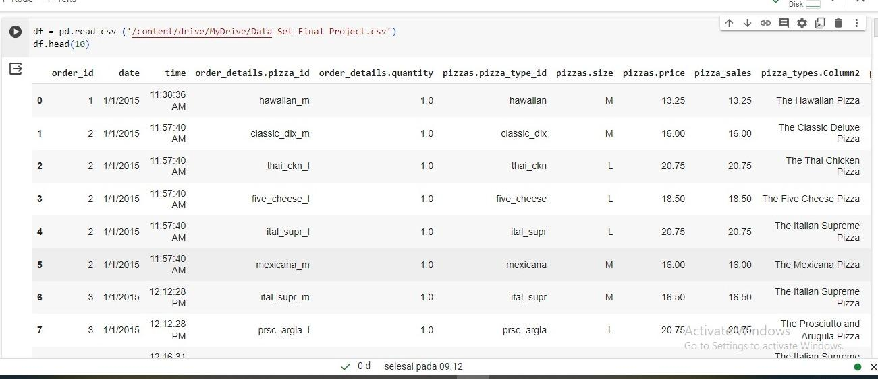
DATA PREPARATION – DATA LOADING

Slide 4
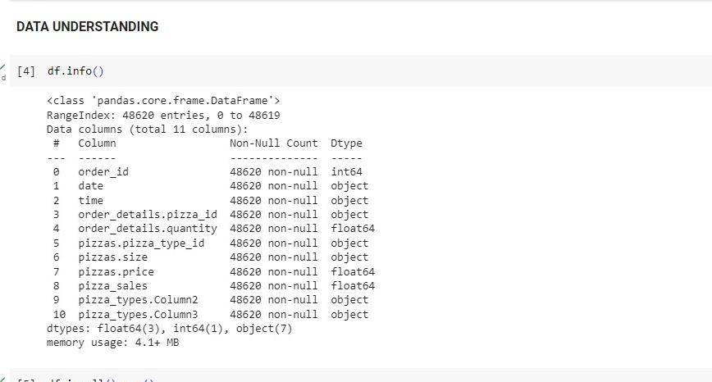
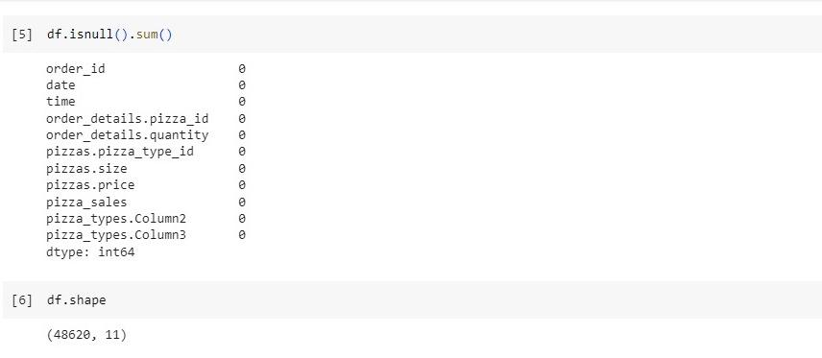
DATA PREPARATION – DATA UNDERSTANDING

Slide 5
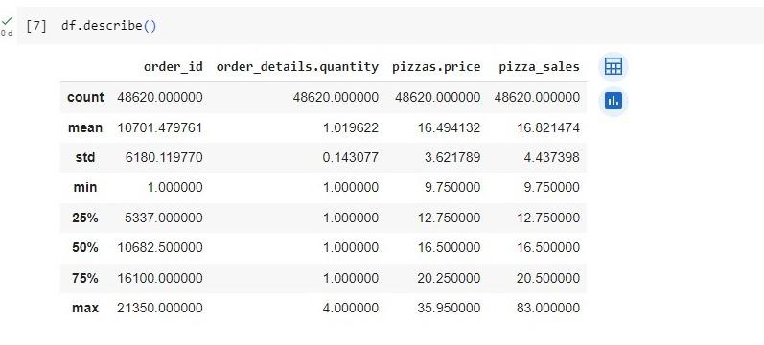
DATA PREPARATION – DATA UNDERSTANDING

Slide 6
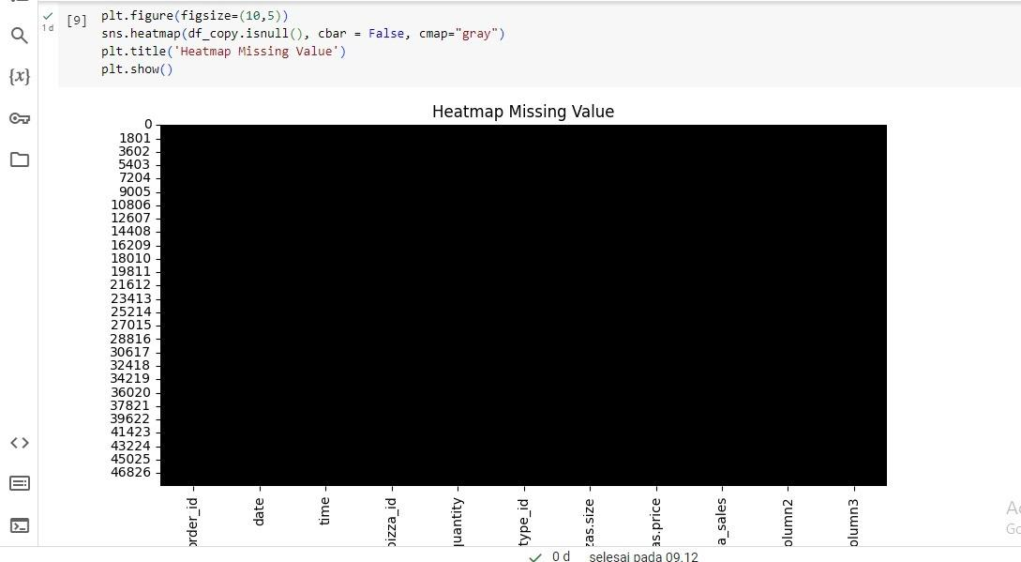
DATA PREPARATION – DATA UNDERSTANDING

Slide 7
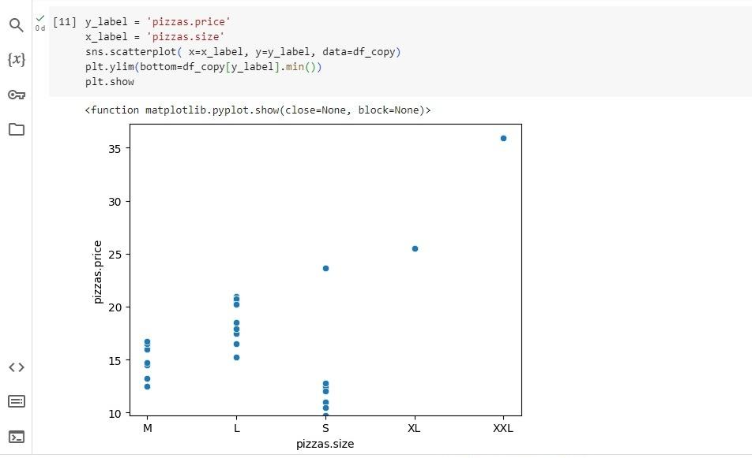
DATA PREPARATION – DATA UNDERSTANDING

Slide 8
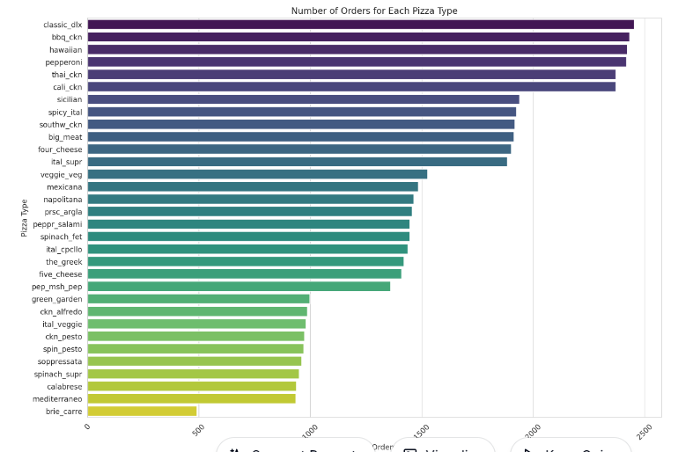

Slide 9
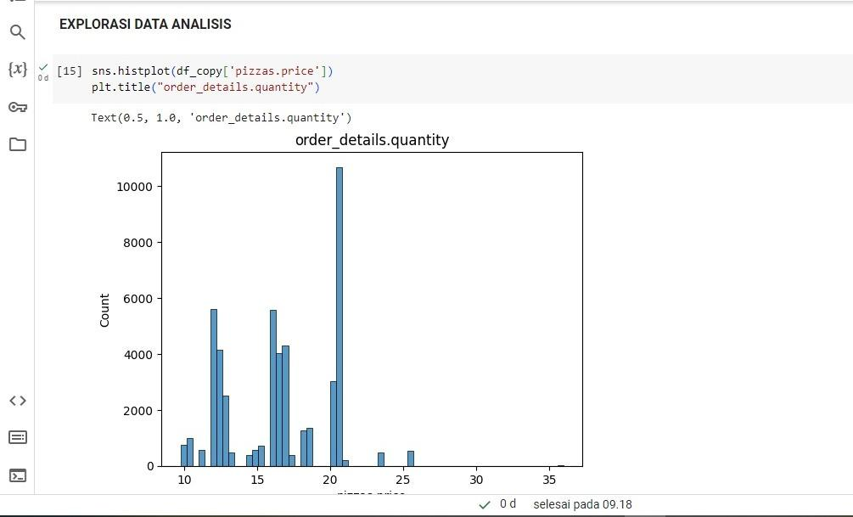
DATA EXPLORATION – DATA ANALISIS

Slide 10
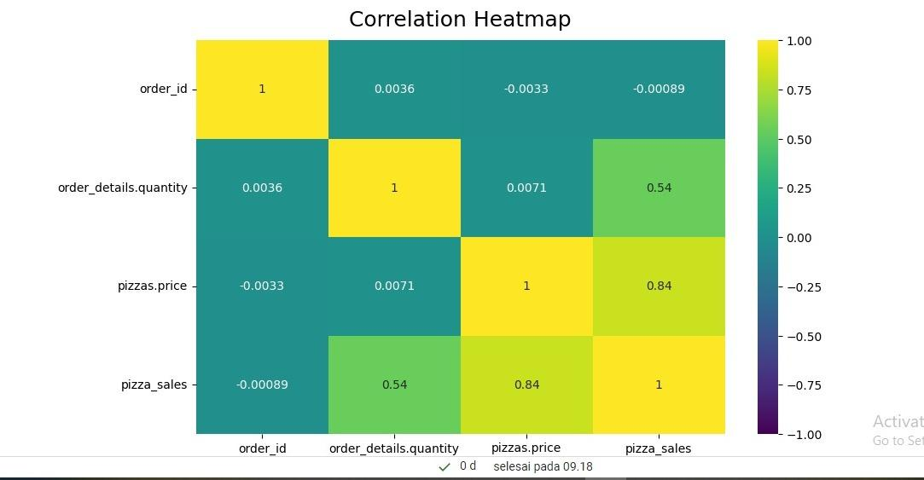
DATA EXPLORATION – DATA ANALISIS

Slide 11
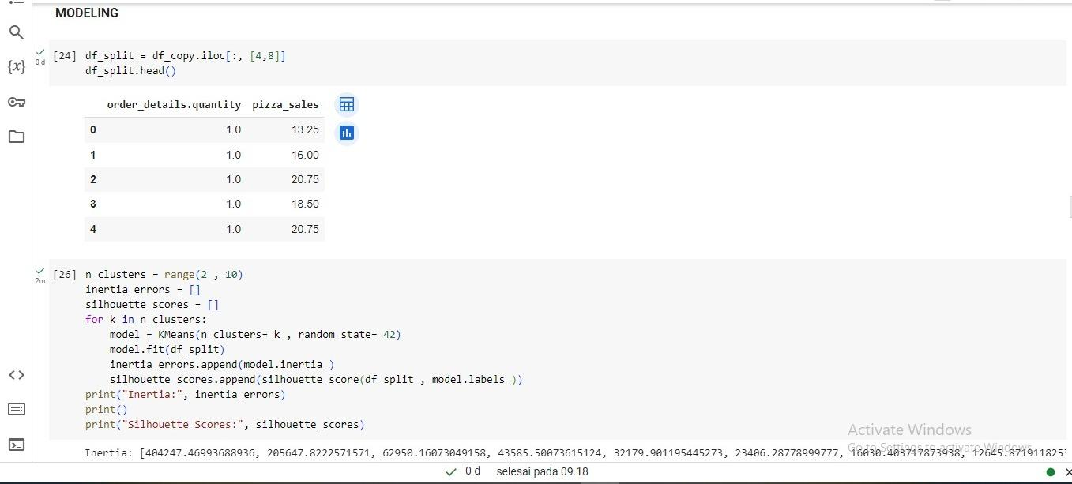
DATA EXPLORATION – MODELLING

Slide 12
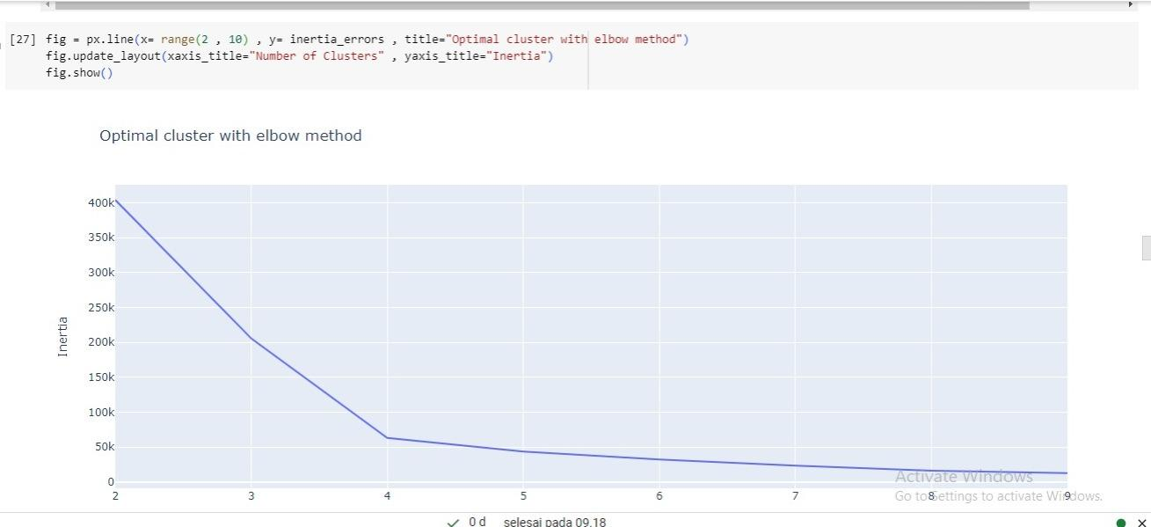
OPTIMAL CLUSTER WITH ELBOW METHOD

Slide 13
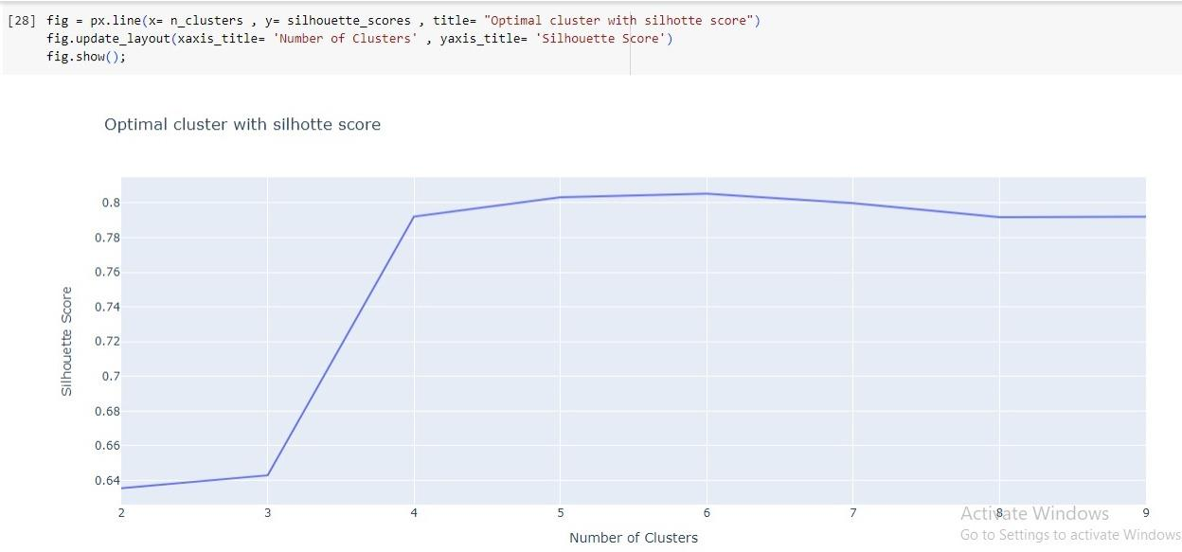
OPTIMAL CLUSTER WITH SILHOUETTE SCORE

Slide 14
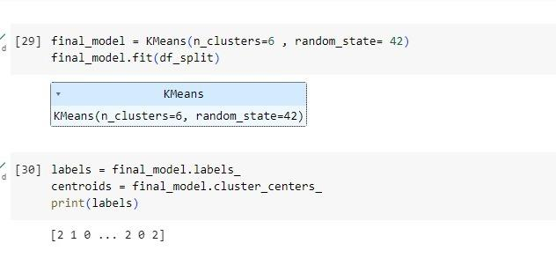
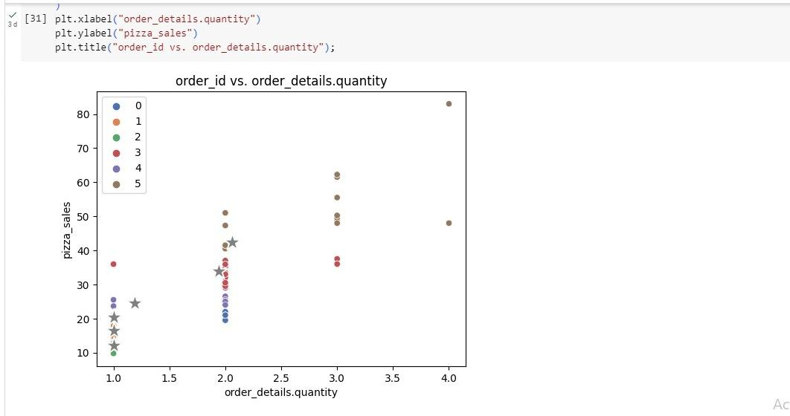
FINAL MODEL - KMEANS

Slide 15
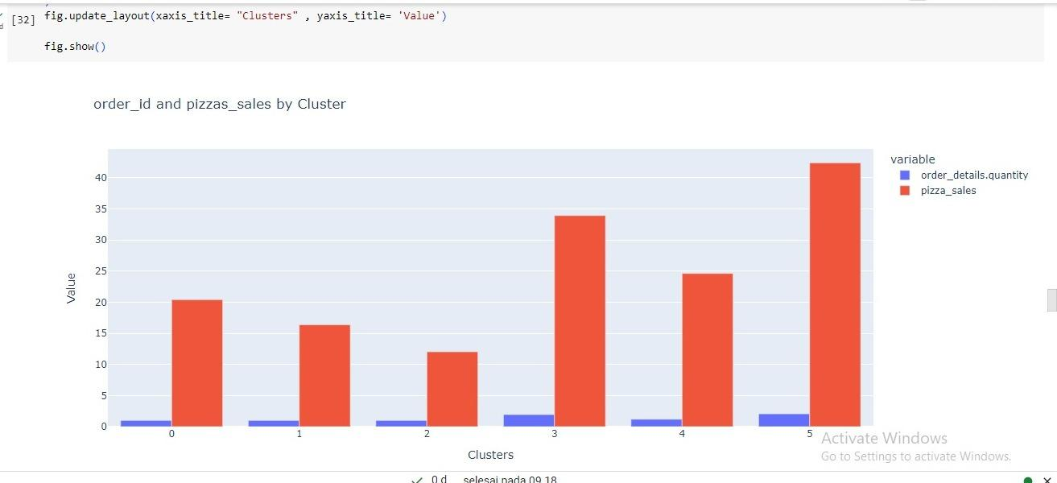
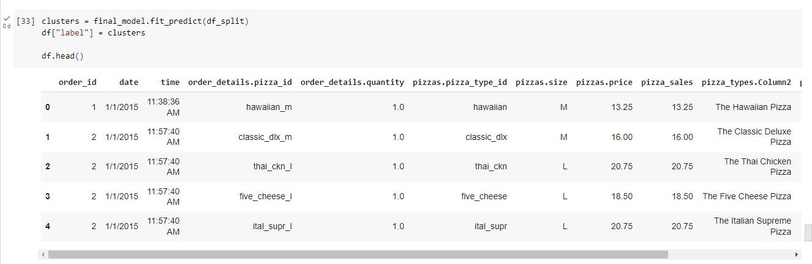
CLUSTER

Slide 16
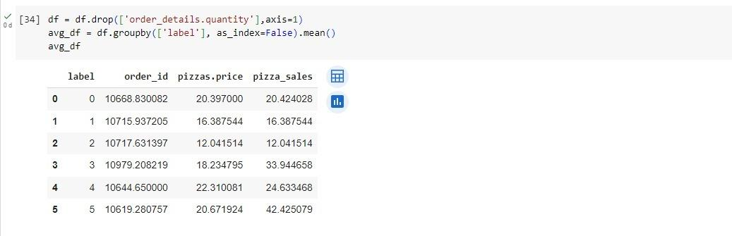
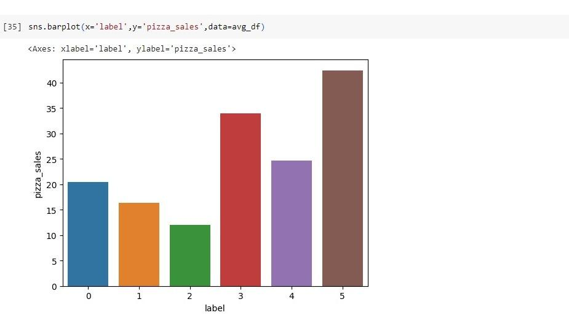
CLUSTER

Slide 17
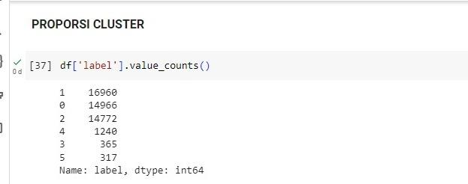
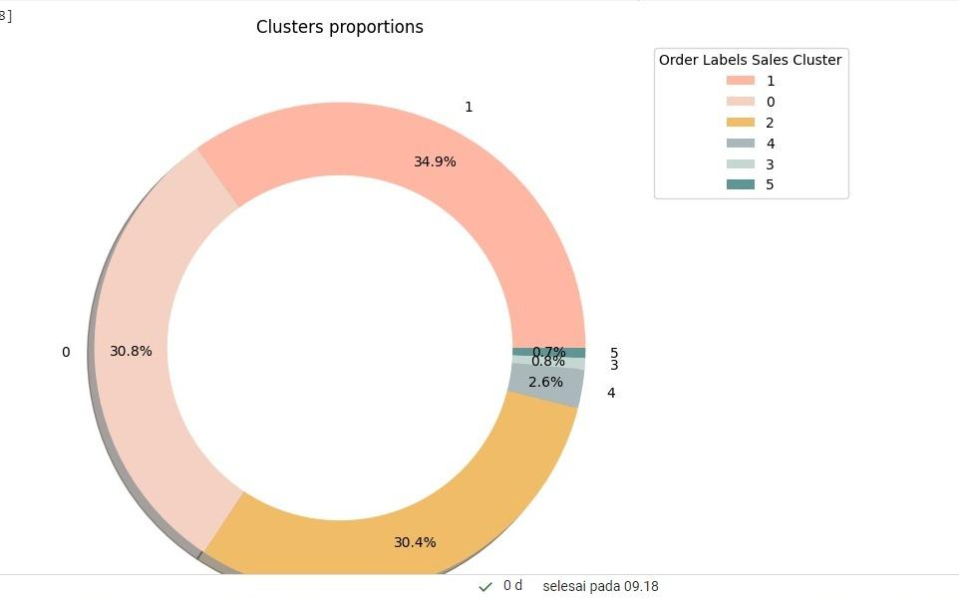
PROPORSI CLUSTER

Slide 18
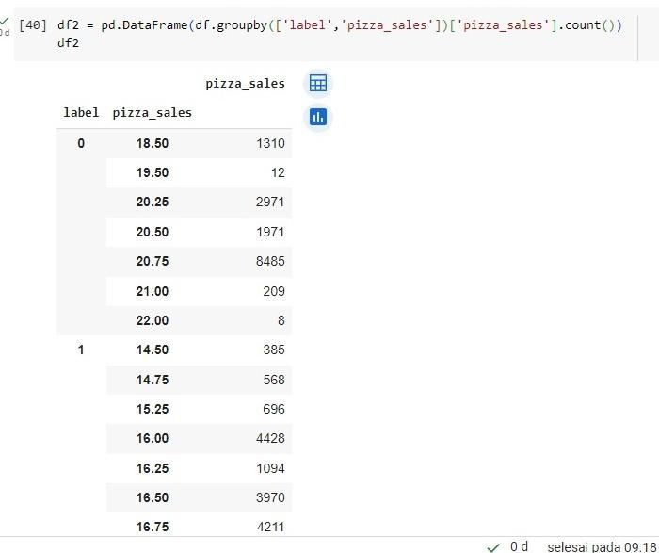
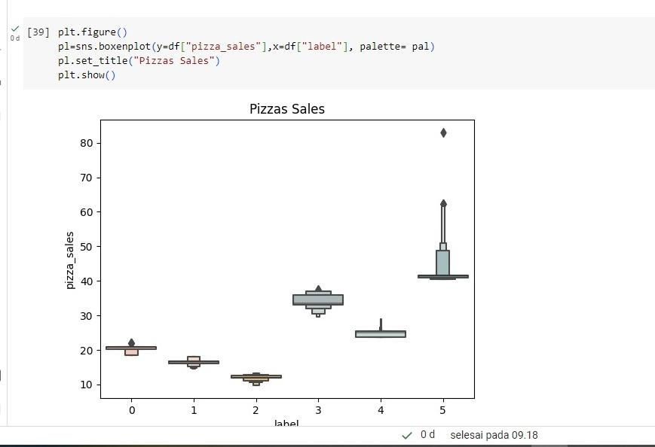
PROPORSI CLUSTER

